Slide 1

MICRON – HF WASTEWATER TREAMENT
BENCH TESTING – Jan 2022
Siva Kumar Kota/Chun Yew
Hiep Le/Sankar
Part 7

Slide 2
Synthetic Water experiments

Slide 3
Preparation of Synthetic HFW+NH4F with IPA (with pH adjustment)
Preferred chemicals | Required quantity for 1 Liter solution (gram)
NH4Cl | 0.059
NaCl | 0.013
CaCl2 | 0.014
HF | 0.843
H3PO4 | 0.206
SiH2O3 | 0.039
H2SO4 | 0.102
IPA | 1
Elements | Desired concentration (ppm) | Calculated concentration based on added chemicals (ppm) | Concentration based on in-house measurement (ppm)
pH | - | - | 3.5
Conductivity | - | - | 3,357 µS/cm
TDS | - | - | 1,134
NH4 | 20 | 20 | 19.7
F | 800 | 800 | 819
SO4 | 100 | 100 | 100
PO4 | 200 | 200 | 214
Cl | 50 | 55.86 | 54.3
Na | 5 | 5 | 721
Ca | 5 | 5 | 1.49
Si | 14.02 | 14.02 | 12.7
COD | - | - | 2,450
TOC | - | - | 473
IPA | 1,000 | 1,000 | 1000

Slide 4
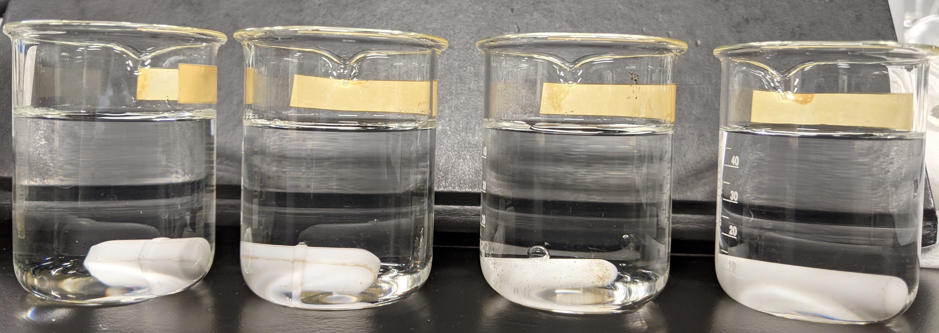
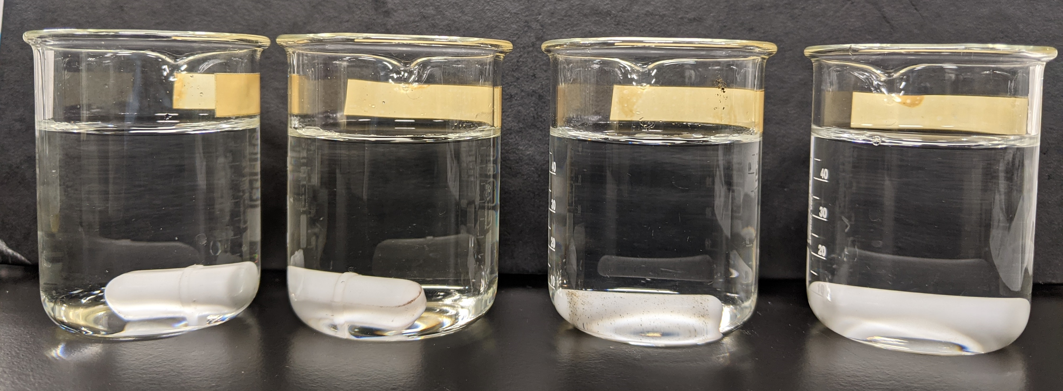
Action item 4: Anti-scalant compatibility test - NF filtration of HFW+NH4F with IPA (with pH adjustment)
Initial solution pH: 3.3, pH adjusted to 3.5
Anti-scalant | pH | Solution appearance
AS1 | 3.0 | Clear
AS2 | 7.19 | Clear
AS3 | 3.7 | Clear
AS4 | 3.58 | Clear
AS4 was selected for the NF filtration experiment because its addition into the feed solution didn’t alter the solution pH much.

Slide 5
Result - NF filtration of HFW+NH4F with IPA (with pH adjustment)
Elements | Concentration for synthetic feed (ppm) | Concentrated feed (ppm) | Permeate (ppm)
pH | 3.5 | 5.04 | 3.29
Conductivity | 3,357 µS/cm | 9,022 µS/cm | 708.6 µS/cm
TDS | 1,134 | 4,921 | 344.4
NH4 | 19.7 | 50.1 | 12.2
F | 819 | 1,555 | 144
SO4 | 100 | 389 | 3.83
PO4 | 214 | 637 | 1.55
Cl | 54.3 | 178 | 21
Na | 721 | 2082 | 86
Ca | 1.49 | <0.1 | <0.1
Si | 12.7 | 73.9 | 51.9
COD | 2,450 | 3935 | 1580
TOC | 473 | 870 | 382
IPA | 1000 | 1640 | 658

Slide 6
Preparation of Synthetic HFW+NH4F with IPA (without pH adjustment)
Preferred chemicals | Required quantity for 1 Liter solution (gram)
NH4Cl | 0.059
NaCl | 0.013
CaCl2 | 0.014
HF | 0.843
H3PO4 | 0.206
SiH2O3 | 0.039
H2SO4 | 0.102
IPA | 1
Elements | Desired concentration (ppm) | Calculated concentration based on added chemicals (ppm) | Concentration based on in-house measurement (ppm)
pH | - | - | 2.92
Conductivity | - | - | 3371 µS/cm
TDS | - | - | 1741
NH4 | 20 | 20 | 20
F | 800 | 800 | 802
SO4 | 100 | 100 | 101
PO4 | 200 | 200 | 161
Cl | 50 | 55.86 | 147
Na | 5 | 5 | 10.1
Ca | 5 | 5 | 4.6
Si | 14.02 | 14.02 | 9.15
COD | - | - | 2523
TOC | - | - | 588
IPA | 1,000 | 1,000 | 1000

Slide 7
Results of NF filtration of HFW+NH4F with IPA (without pH adjustment)
Elements | Concentration for synthetic feed (ppm) | NF concentrated feed (ppm) | NF Permeate (ppm)
pH | 2.92 | 2.08 | 2.26
Conductivity | 3371 µS/cm | 4821 µS/cm | 3071 µS/cm
TDS | 1741 | 2535 | 1580
F | 802 | 1328 | 456
SO4 | TBC | 201 | 88.9
PO4 | 161 | 203 | 150
Cl | TBC | 152 | 147
Na | 10.1 | 30.9 | 4.72
Ca | 4.6 | 21.5 | 0.105
Si | 9.15 | 41.5 | 4.19

Slide 8
Result – NF and RO filtration of HFW+NH4F with IPA (without pH adjustment)
Elements | Concentration for synthetic feed (ppm) | NF concentrated feed (ppm) | NF Permeate (ppm) | RO permeate (ppm)
pH | 2.92 | 2.08 | 2.26 | 2.53
COD | 2523 | 2970 | 2013 | 67
TOC | 588 | 691 | 484 | 16.2
IPA | 1000 | 1238 | 839 | 28

Slide 9
Result – NF and RO filtration of HFW+NH4F with IPA (without pH adjustment)
Elements | Concentration for synthetic feed (ppm) | NF concentrated feed (ppm) | NF Permeate (ppm) | RO concentrated feed (ppm) | RO permeate (ppm)
pH | 2.15 | 2.3 | 2.3 | 2.31 | 2.9
Conductivity | 3376 µS/cm | 3298 µS/cm | 1905 µS/cm | 2416 µS/cm | 493.1 µS/cm
TDS | 1730 | 3001 | 945.5 | 1230 | 214.4
NH4 | 20.4 | 67 | 9.7 | 17.6 | 1.3
F | 813 | 1959 | 203 | 333 | 48.5
SO4 | 102 | 299 | 55 | 11.6 | 0.286
PO4 | 187 | 4.3 | 72 | 9.59 | <0.1
Cl | 147 | 265 | 140 | 131 | 8.77
Na | 2.6 | 30.45 | <0.1 | <0.1 | <0.1
Ca | 6.5 | 25.2 | 1.8 | 1.73 | <0.1
Si | 12.2 | 39.5 | 3.4 | 9.69 | 0.221

Slide 10
Result – NF and RO filtration of HFW+NH4F with IPA (without pH adjustment) – Trial 2
Elements | Concentration for synthetic feed (ppm) | NF concentrated feed (ppm) | NF Permeate (ppm) | RO concentrated feed (ppm) | RO permeate (ppm)
pH | 2.15 | 2.3 | 2.3 | 2.31 | 2.9
COD | 2390 | 3456.7 | 1533.3 | 2791.67 | 27.33
TOC | 570 | 812 | 369 | 656 | 7.58
IPA | 1000 | 1024 | 639 | 1163 | 11
COD to IPA conversion is 2.4 times

Slide 11
Micron HFW - Eq Tank outlet sample testing

Slide 12
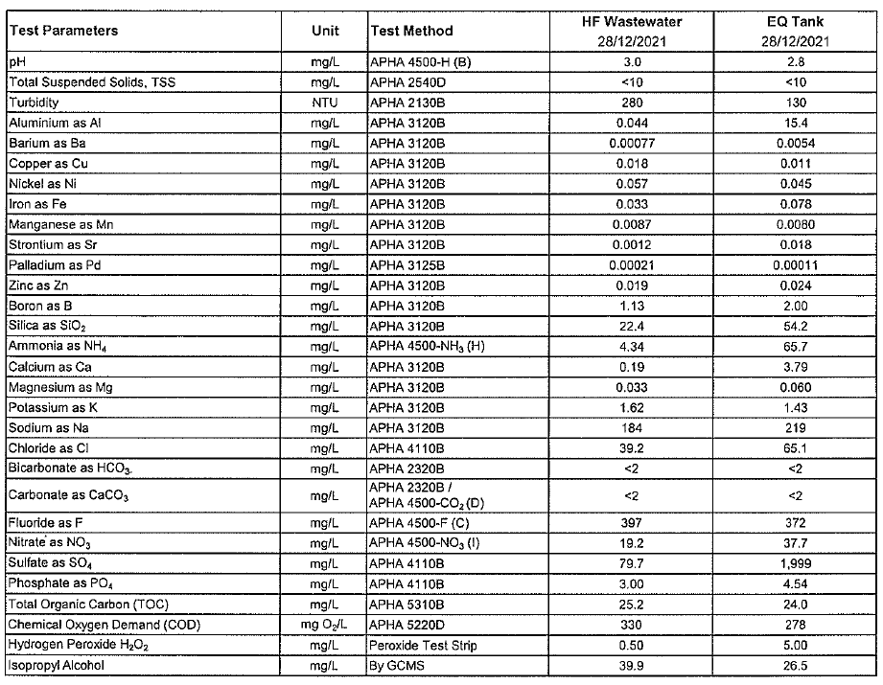
HFW Eq Tank Wastewater analysis
Notes:
10x and 10n, 10a

Slide 13
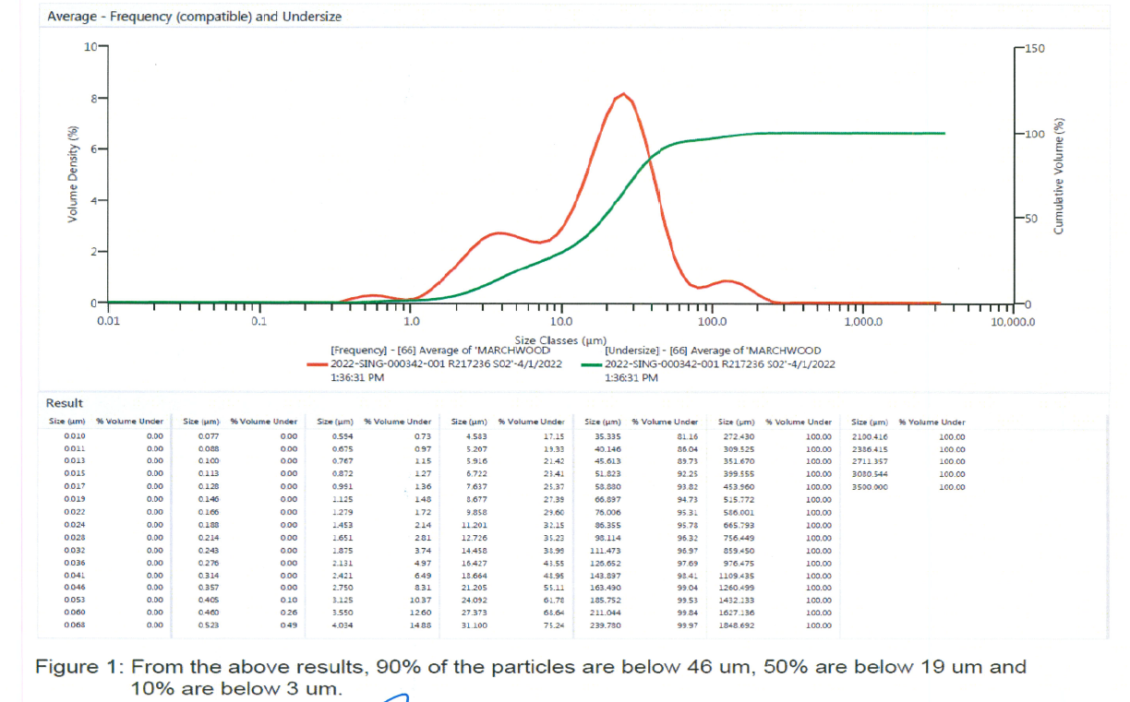
HFW Eq Tank Wastewater – Particle size distribution

Slide 14
1st Pass - NF of Mixed wastewater from EQ Tank
Membrane used: Microdyn Trisep TS40 or NF270
Recovery: 75%
Final bulk feed quality:
pH: 3.26
Conductivity: 4123 µS/cm
TDS: 2150 ppm
Final bulk permeate quality:
pH: 3.21
Conductivity: 805.7 µS/cm
TDS: 393.6 ppm

Slide 15
1st Pass - NF of Mixed wastewater from EQ Tank

Slide 16
2nd Pass - RO of NF permeate
Membrane used: SW30XHR
Recovery: 80%
Final bulk feed quality:
pH: 3.73
Conductivity: 2237 µS/cm
TDS: 1131 ppm
Final bulk permeate quality:
pH: 3.13
Conductivity: 292.6 µS/cm
TDS: 139.7 ppm

Slide 17
2nd Pass - RO of NF permeate

Slide 18
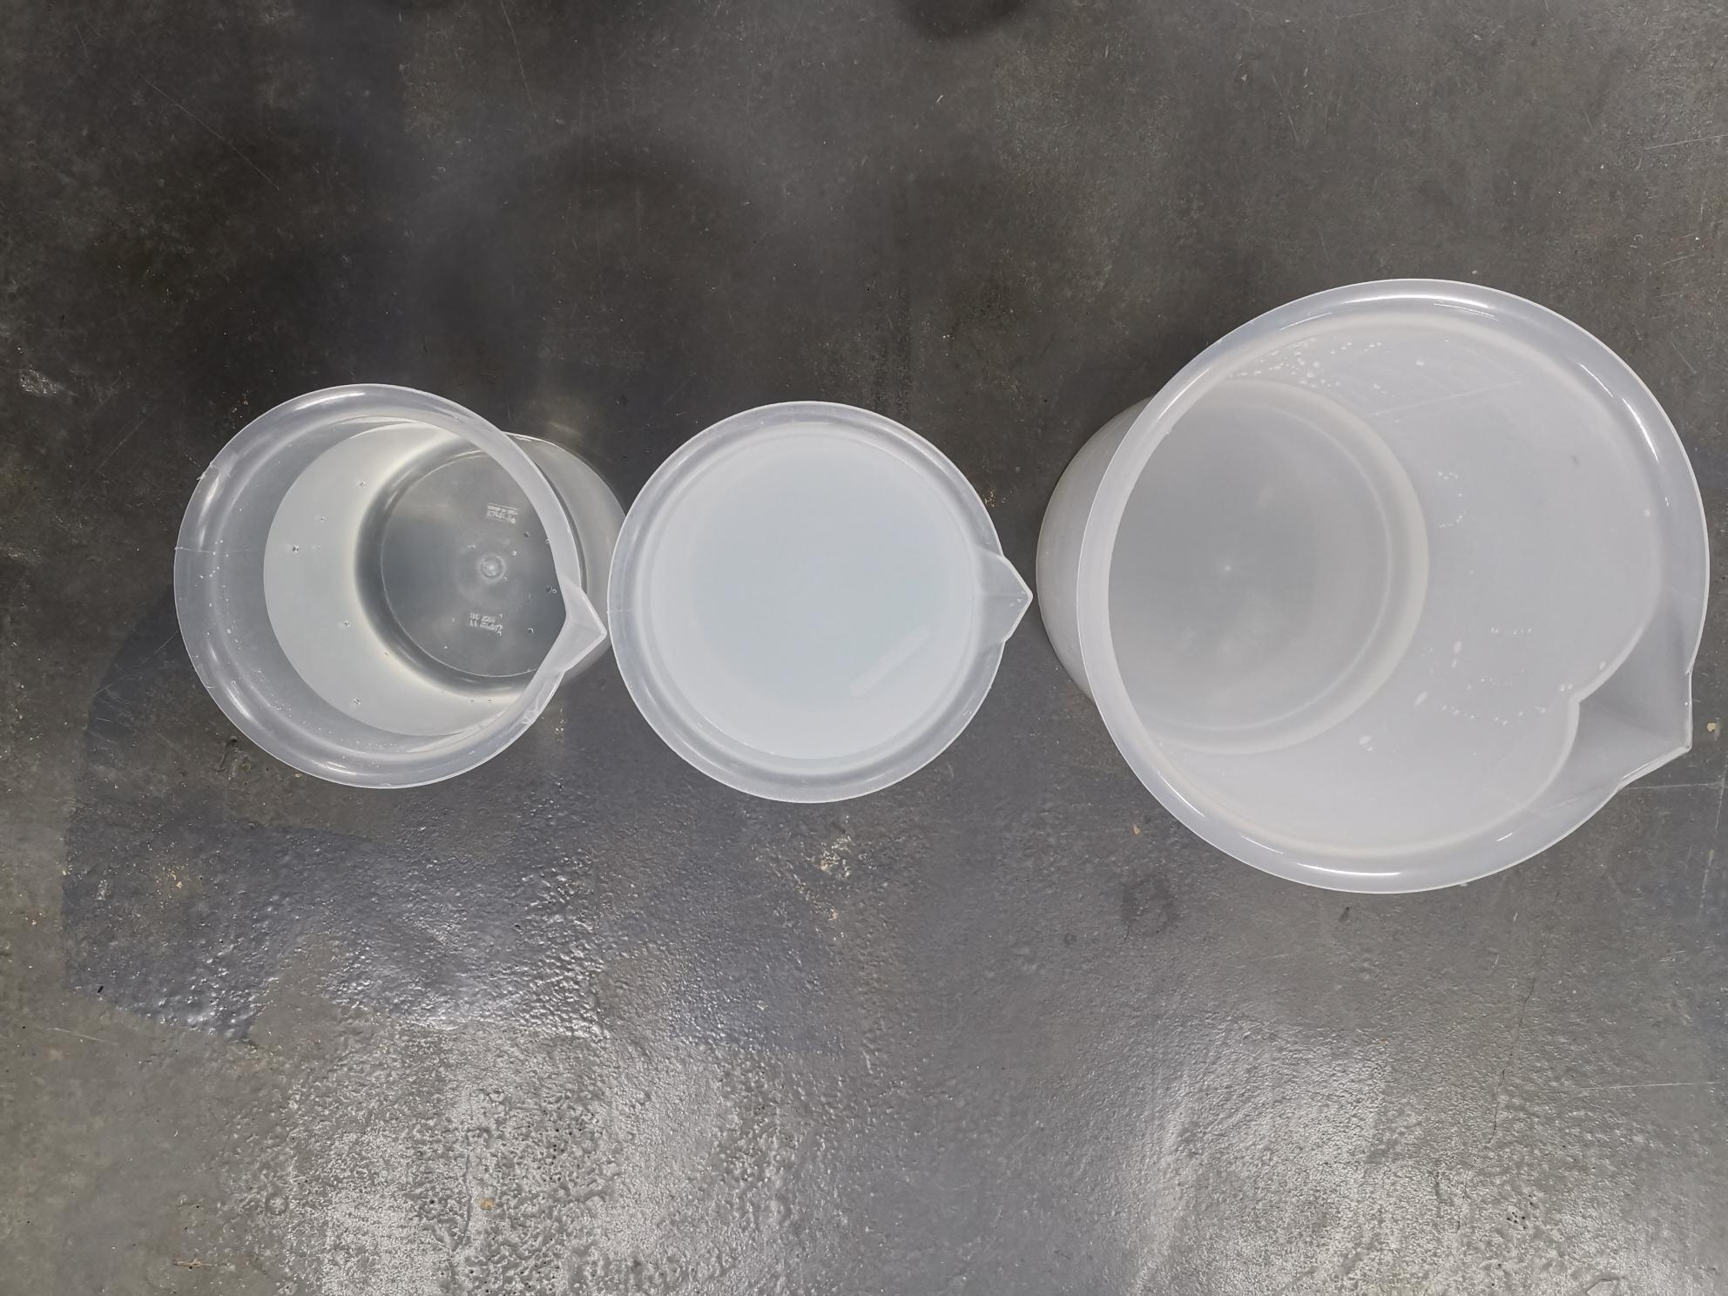
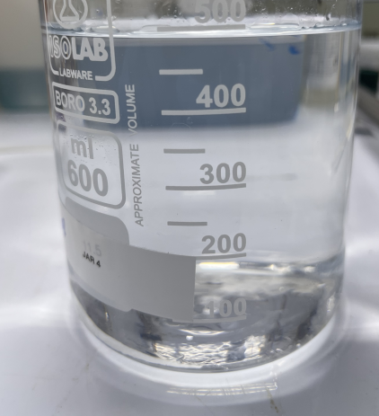
Result – NF and RO filtration of mixed HFW wastewater from EQ Tank
Feed
Elements | Mixed wastewater from EQ tank (mg/L) | NF concentrate (mg/L) | NF Permeate (mg/L) | RO concentrate (mg/L) | RO permeate (mg/L)
pH | 2.8 | 3.26 | 3.21 | 3.73 | 3.13
Conductivity | 2267 µS/cm | 4123 µS/cm | 805.7 µS/cm | 2237 µS/cm | 292.6 µS/cm
TDS | - | 2276 | 394 | 1131 | 139
NH4 | 65.7 | 150 | 28.9 | 113 | <1
F | 372 | 1002 | 95.1 | 291 | 23.0*
SO4 | 1999 | 1168 | 34.5 | 140 | 0.23
PO4 | 4.54 | <5 | 1.27 | <5 | <0.1
Cl | 65.1 | 91.3 | 50.8 | 213 | 2.63
Na | 219 | 512 | 67.8 | 196 | <0.1
Ca | 3.79 | 12.3 | <0.1 | <0.1 | <0.1
Si | 25.3 | 50.4 | 15.1 | 54.8 | <0.1
COD | 278 | 150 | 70 | 275 | <10
TOC | 24 | 39.9 | 19.1 | 62.7 | 2.60
IPA | 26.5 | - | - | - | -
COD/IPA conversion is 2.4 times
* Fluoride value needs to retest. This may be analytical error.
Permeate
Notes:
Mec AND hrscc

Slide 19
backup

Slide 20
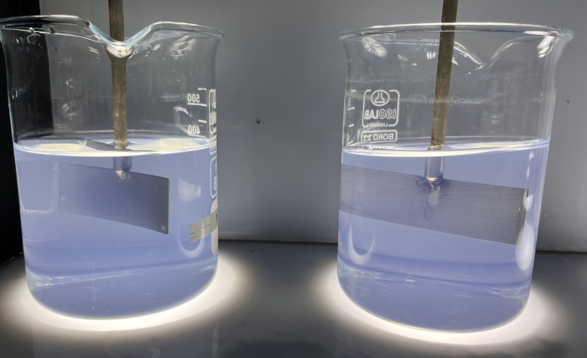
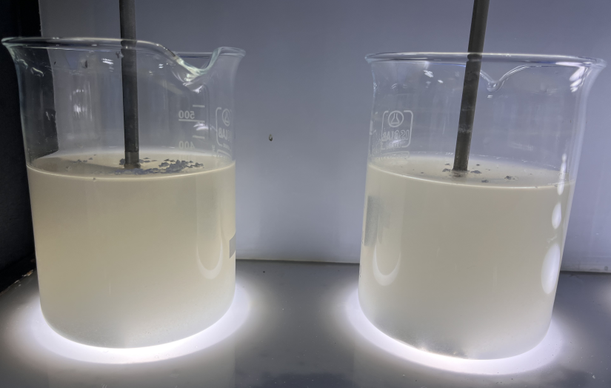
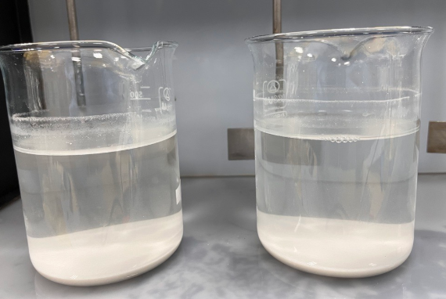
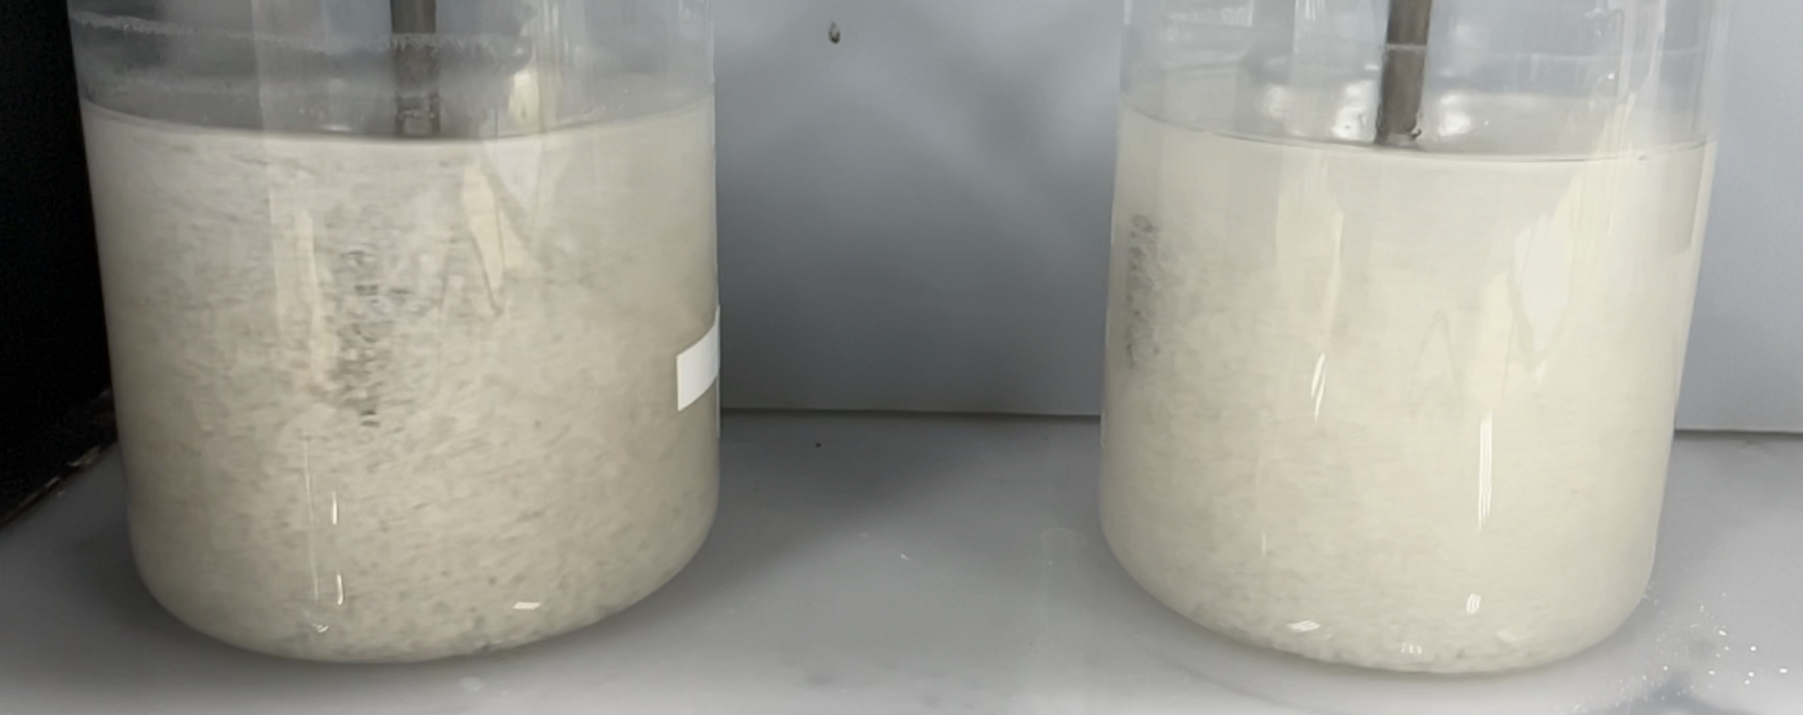
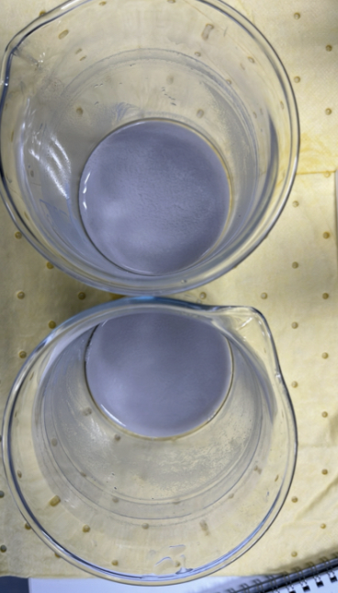
Reject treatment – Jar testing
Case 1:
4000mg of Ca(OH)2 in 400ml RO reject
Case 2:
2400mg of Ca(OH)2 & 1600mg of CaCl2
in 400ml RO reject
Notes:
Cu-12 ppm (200)
Ni- 6 ppm (60)
Pd-1 ppm

Slide 21
Jar Testing results
Elements | Jar test 1 | Jar test 2
pH | 12.43 | 7.2
TDS | 3495 | 7354
F | 9.45 | 7.6
PO4 | <1 | <1
Cl | 61.03 | 1917
Jar test 1: 10000 mg/l of Ca(OH)2
Jar test 2 : 6000mg/l Ca(OH)2+4000mg/l CaCl2

Slide 22
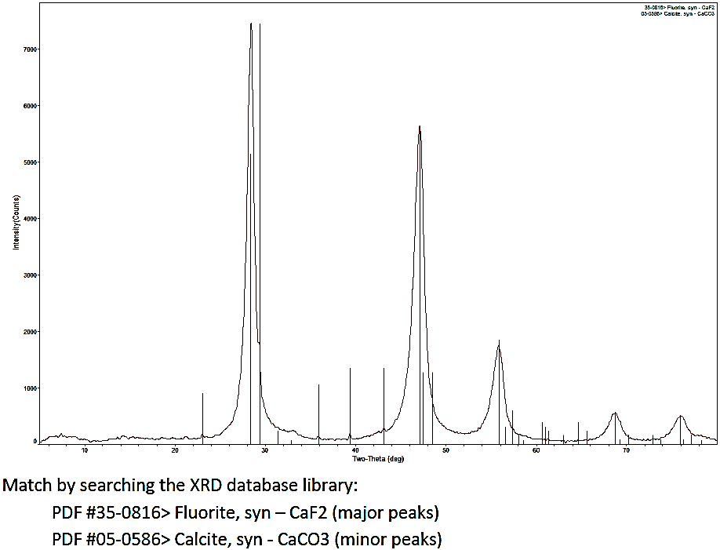
^{Jar Test Sludge - XRD analysis}
Dosage: 6000 mg/l of lime and 4000 mg/l of CaCl2
22

Slide 23
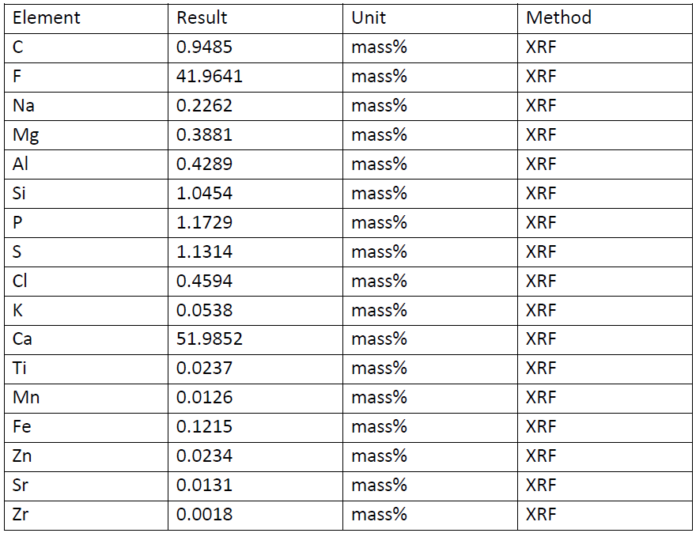
^{Jar Test Sludge - XRF analysis}
XRF Results shows that Calcium fluoride sludge as a major part (>80%)
Dosage: 6000 mg/l of lime and 4000 mg/l of CaCl2
23

Slide 24
Action item 5: Jar testing of Synthetic Combined NF RO Reject (without pH adjustment)– Testing 4
Jar | Polymer added | Chemical's dosage | Supernatant turbidity (NTU)
1 | Flopam AN 934 SH | 6000 ppm lime + 500 ppm CaCl2 | 9.98
2 | Flopam AN 934 SH | 6000 lime + 4000 ppm CaCl2 | 20.4
Elements | Concentration based on in-house measurement (ppm) | Supernatant quality for Jar 1 | Supernatant quality for Jar 2
pH | 3 | 9.68 | 9.29
Conductivity | 7745 | 1941 µS/cm | 7256 µS/cm
TDS | 4175 | 974.7 | 3889
F | 2304 | 22 | 7.51
SO4 | TBC | 150 | 137
PO4 | 389 | <1 | <1
Na | 7.74 | 8.2 | 25.4
Ca | 7.94 | 295 | 1290
Si | 41.2 | 14.9 | 5.66

